Slide 1
C22 Food production
IGCSE Biology
Wendy Chai

Slide 2

Contents
Food production
Habitat destruction
Pollution
Conservation - resources
Conservation - species

Slide 3
Food production - outline
Introduction
What are cereal grains
Modern agriculture technology - farm machinery
Modern agriculture technology - Fertilisers
Modern agriculture technology - Pesticide
Modern agriculture technology - Selective breeding
Famine
Monoculture
Intensive livestock farming
Impacts on environment of food production

Slide 4
Food production
The efficient supply of food from the land to consumers is of great importance.
To feed a growing human population, it is necessary that farmers increase the yields of their crops.
Over the last century several methods have been used to increase the amount of food that can be made available for consumers.

Slide 5
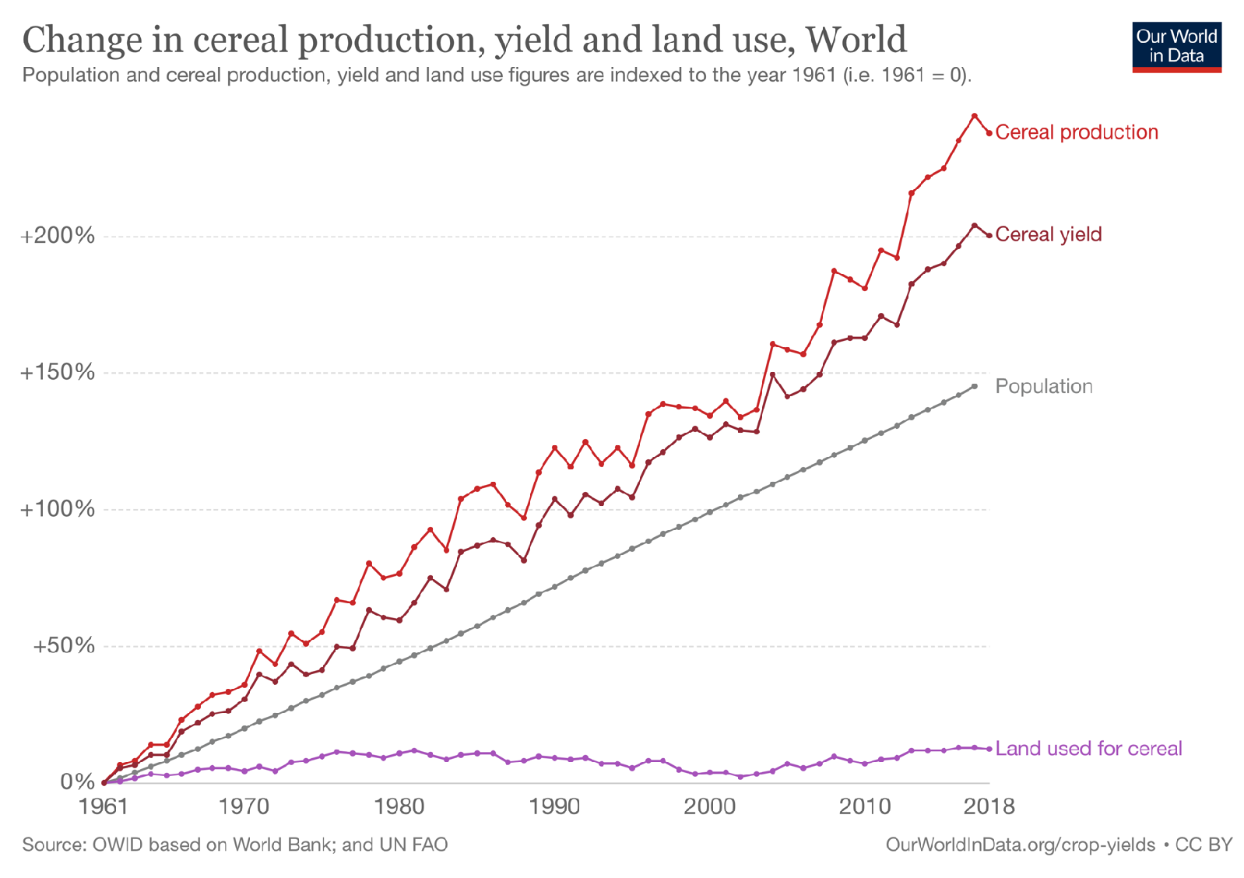
Food production
Notes:
In the chart we see index trends in cereal production, yield, land use and population measured from 1961 (i.e. 1961 = 100). From 1961 to 2014, global cereal production has increased by 280 percent. If we compare this increase to that of total population (which increased only 136 percent over the same period), we see that global cereal production has increased at a much faster rate than that of population. If distributed equally, cereal production per person has increased despite a growing population.
Have we achieved this through land expansion or improved yields? A bit of both.
Most of our improvements in cereal production have arisen from improvements in yield. The average cereal yield has increased by 175 percent since 1961. Today, the world can produce almost three-times as much cereal from a given area of land as it did in 1961.
The trade-off between higher yields and land use.

Slide 6
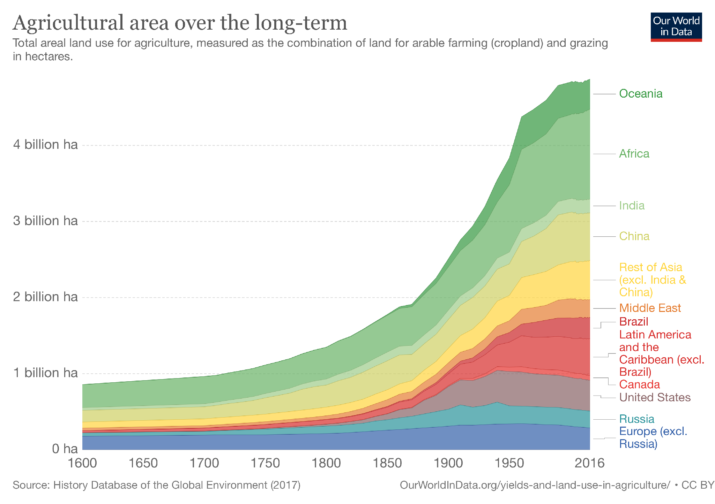

Slide 7
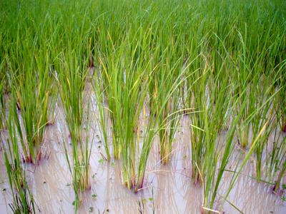
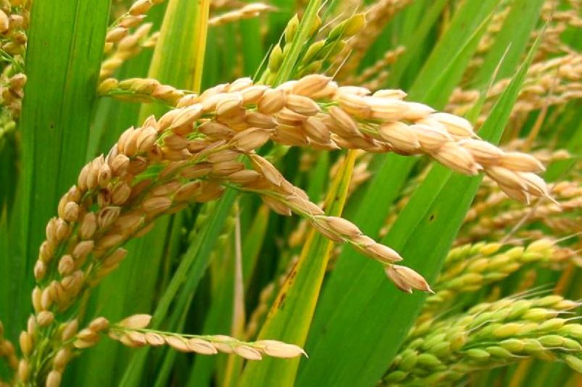
Cereal grains
Cereal grains (or simply grains) are small, hard and edible dry seeds that grow on grass-like plants called cereals.
They are a staple food in most countries.
Today, the most commonly produced and consumed grains are corn (or maize), rice, and wheat.
Other grains that are consumed in smaller amounts include barley, oats, sorghum, millet, rye and several others.
Rice

Slide 8
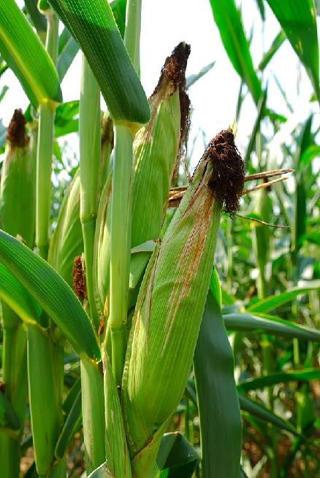
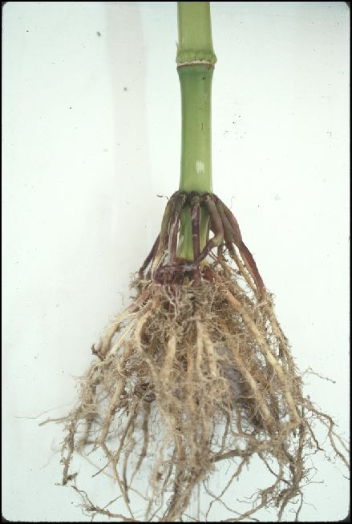
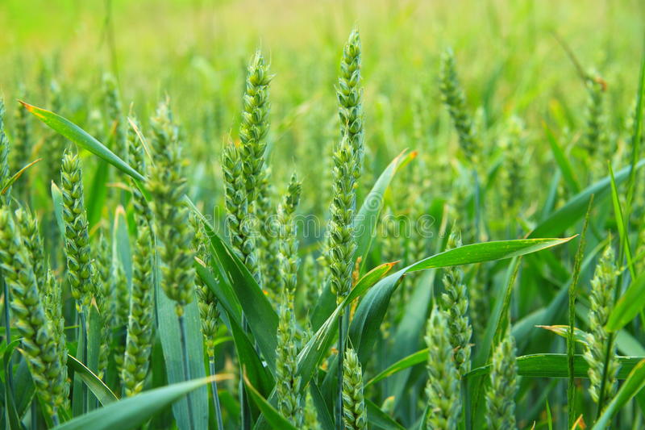
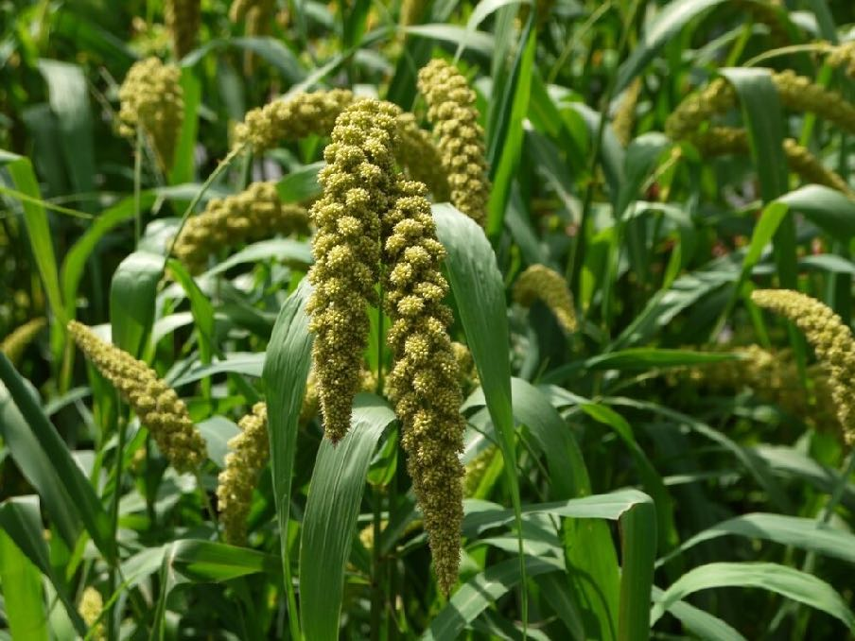
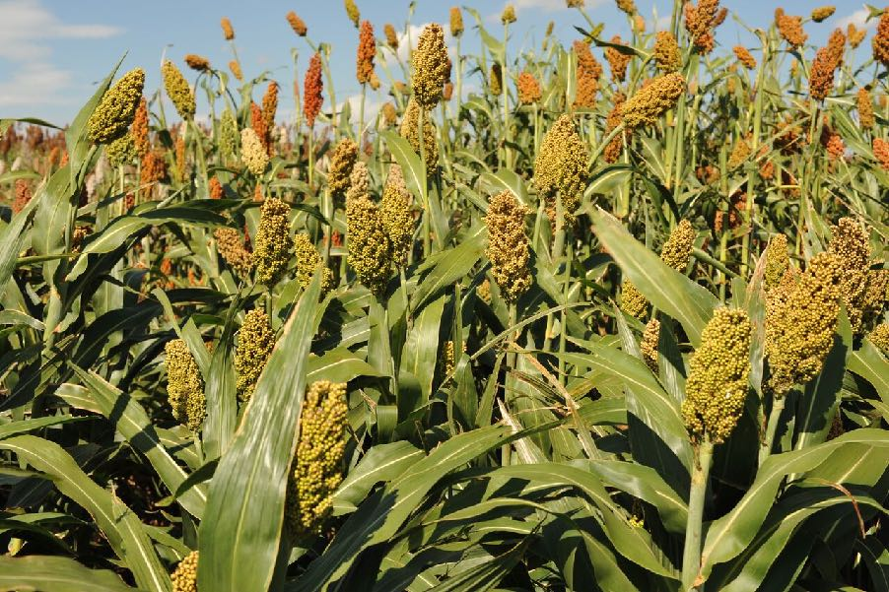
Corn/ Maize
Wheat
Sorghum
Millet

Slide 9
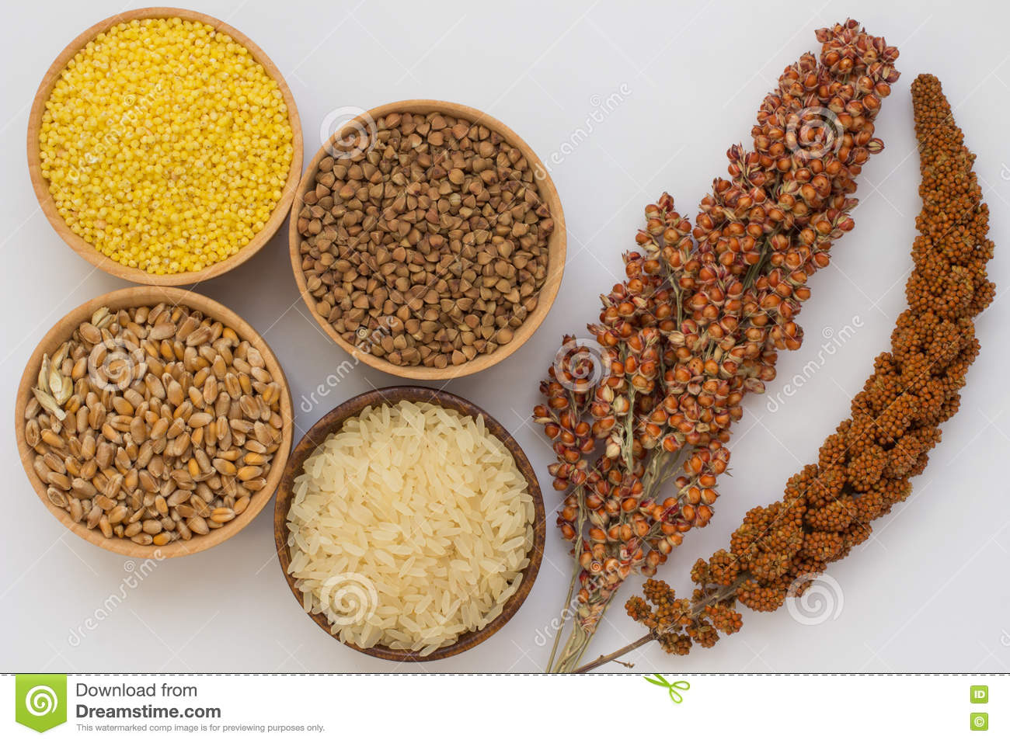
twig red millet, sorghum, grain buckwheat, millet, rice, wheat

Slide 10
Modern agriculture technology - farm machinery
1) Tractor: used to pull a variety of farm machinery
2) Combine (harvester): reap/ harvest, thresh and winnow grain plants (cut a crop & separate the grains from rest of the plant)
3) plough: digging & turning soil for planting
4) planter or seeder: plant seeds;
5) transplanter: transplant seedlings into the field, and may be partially or fully automated.
6) irrigation machinery
7) sprayer, and etc.
Increase food production by:
a) Reduce labor and increasing efficiency;
b) Allow one person to work larger areas of land
Bonus vocabulary: grains, automate/ mechanize, farm implement, plow/ plough, soil cultivation, sow seeds, hand-held implements, animal-drawn machinery

Slide 11
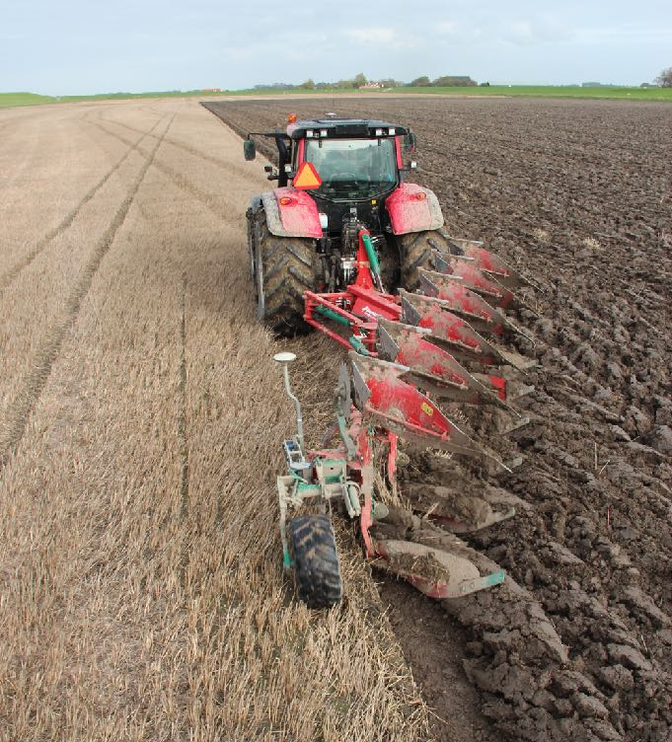
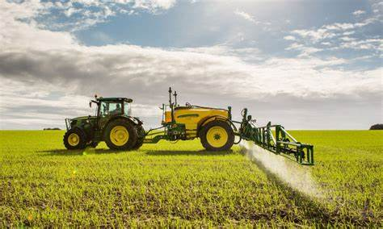

Slide 12
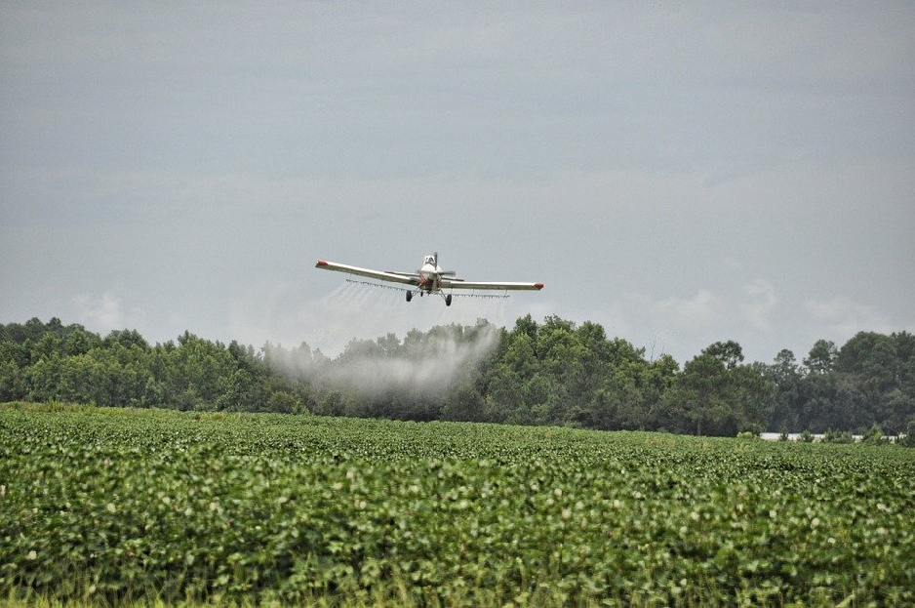
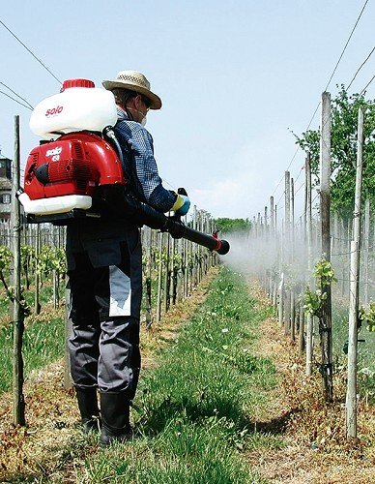

Slide 13
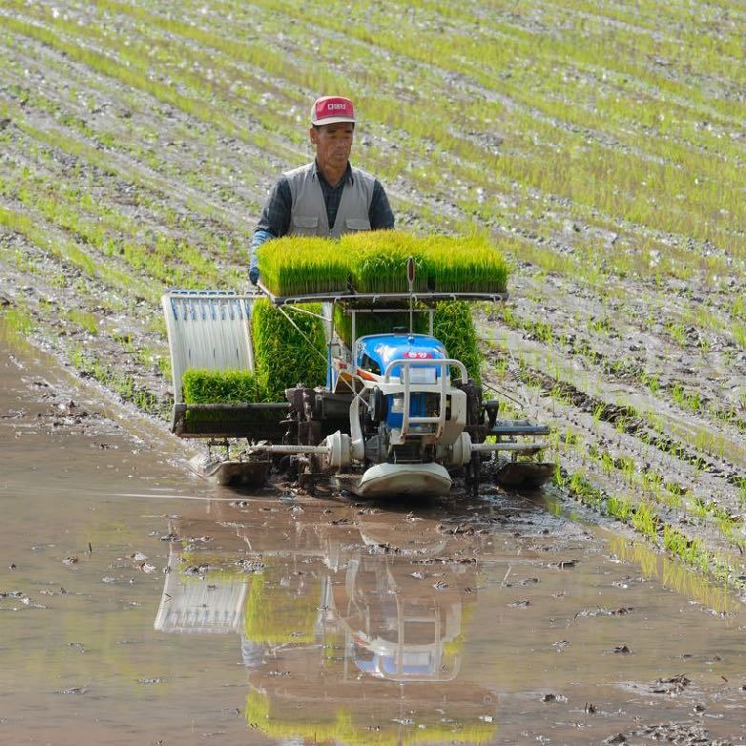
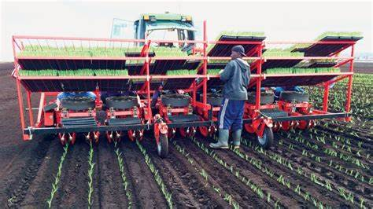
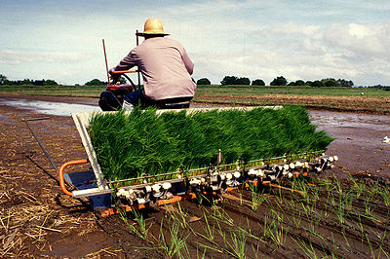
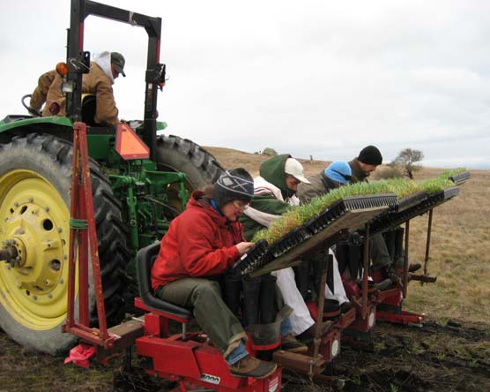

Slide 14
Modern agriculture technology - fertilisers
Chemical fertilisers are used to increase the growth of crop plants, which increases the yield of the crop.
Chemical fertilisers are synthetic substances that usually contain a mixture of nutrients – NPK (usually in the form of nitrate, phosphate and potassium ions).
They can be spread quickly and efficiently by agricultural machinery.
E.g. urea, ammonium nitrate, potassium nitrate, potassium chloride, monoammonium phosphate
Any possible harmful effects?

Slide 15
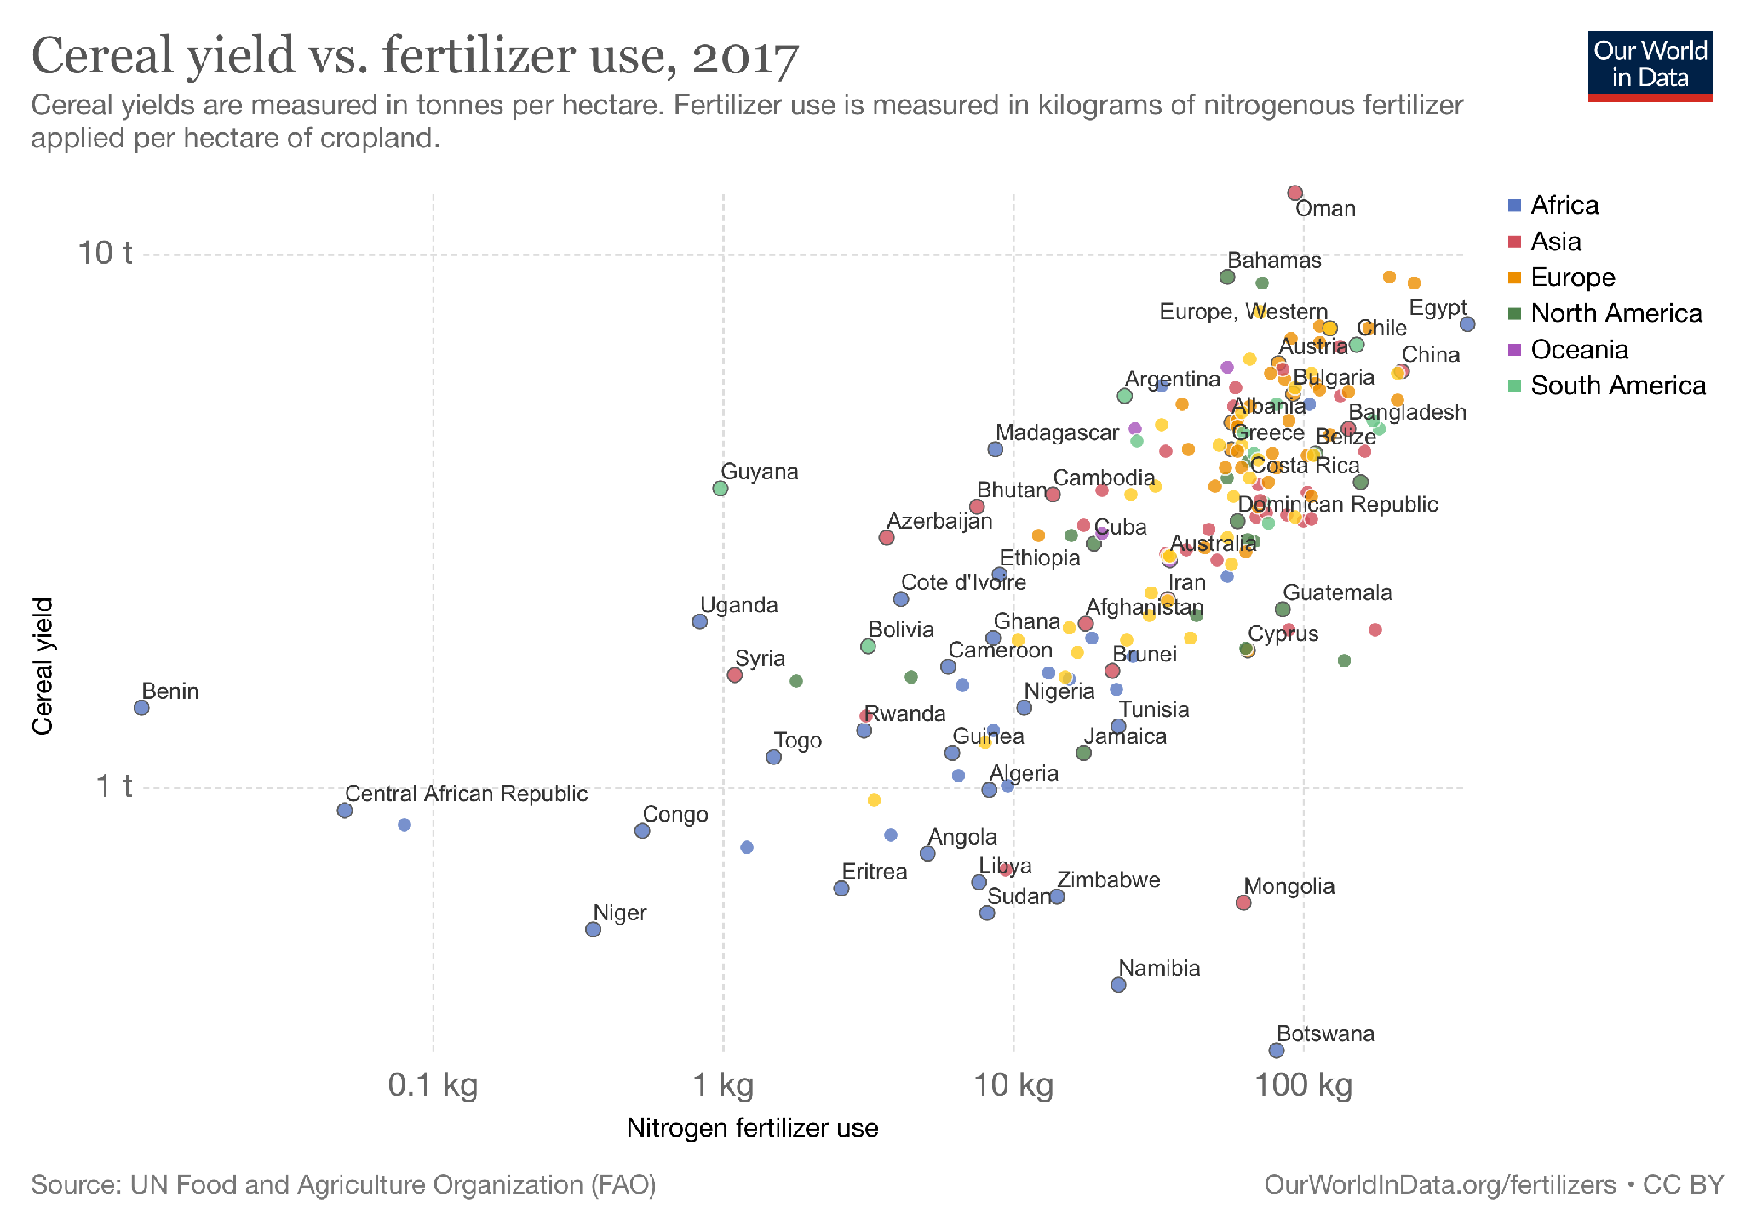

Slide 16
Modern agriculture technology - pesticides
Pesticides are used to kill/ control pests that damage crops, including weeds. This includes all of the following:
insecticide (kill insects, improve quality and yield)
fungicide (prevent the growth of fungi, like molds and mildew)
nematicide (kill nematodes)
Herbicides (kill weeds and other unwanted vegetation, reduce competition with weeds)
These insects, fungi and nematodes feed on crops – which would reduce the crop quality and yield.
Weeds compete with crop plants for water, light and nutrients.
The most common of these are herbicides which account for approximately 80% of all pesticide use.
The yield loss potential among all crops without weed control is about 37%; through the use of effective herbicides, these losses have been reduced to about 9% through all cropping systems.

Slide 17
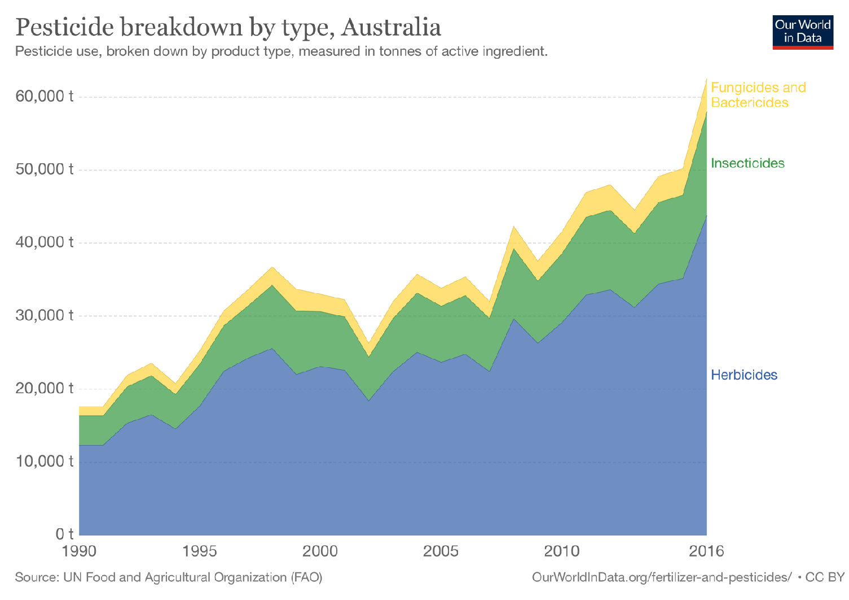
Modern agriculture technology - pesticides

Slide 18
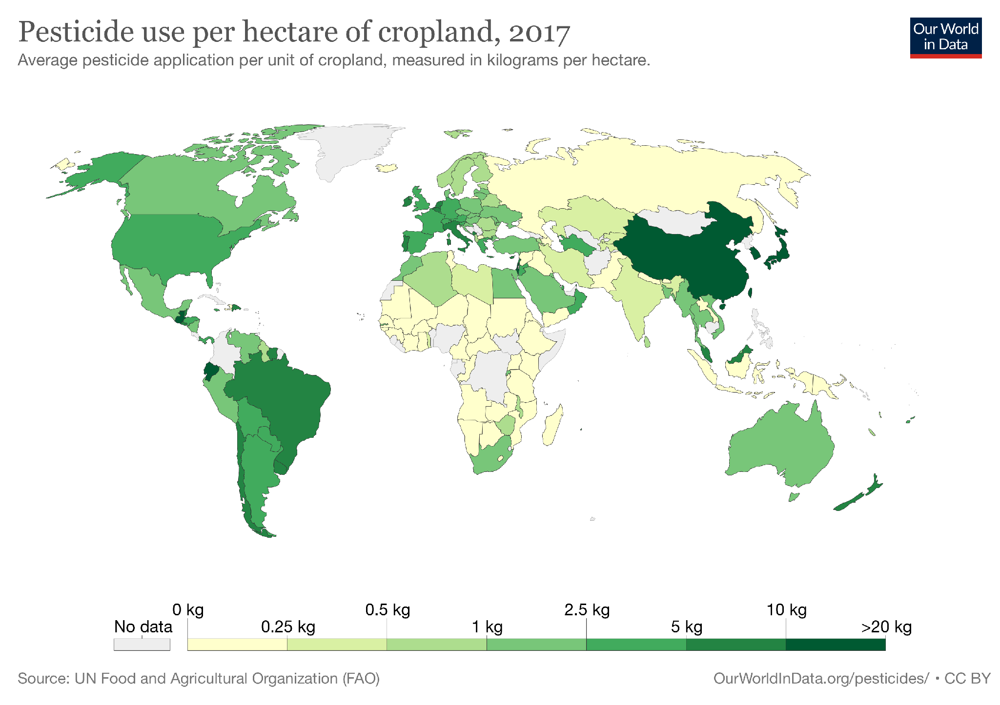

Slide 19
Improving varieties - Selective breeding
Artificial selection, also known as selective breeding, means human select those with desirable traits and only allow them to breed, generation after generation.
Artificial selection has increased the yields of crops and made them more resistant to poor soil, drought and diseases.
It has been used to produce animals with more meat, more milk, more wool etc., as well as a wider variety of forms.
Artificial selection has been used with farm crops and domesticated animals for thousands of years.

Slide 20
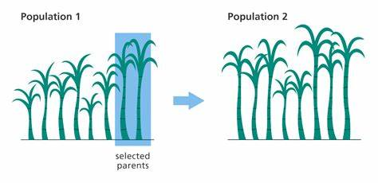
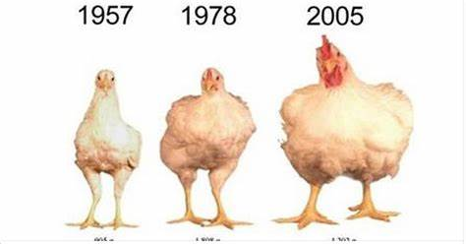
Improving varieties - Selective breeding

Slide 21
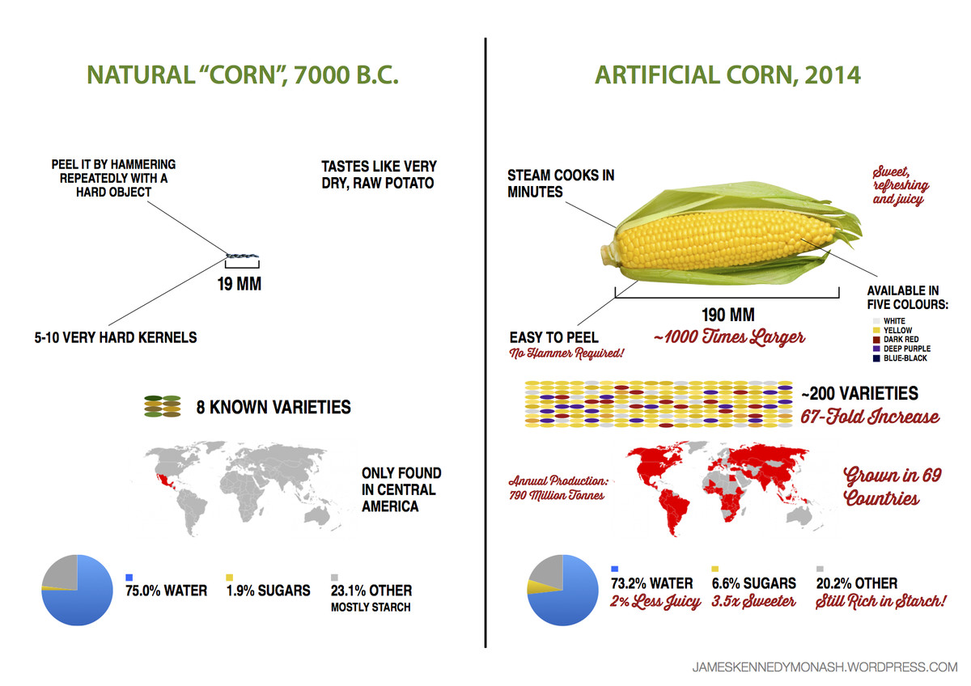

Slide 22
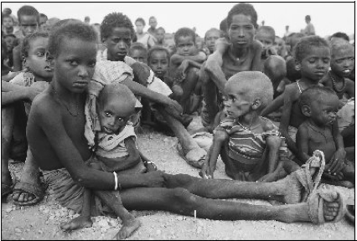
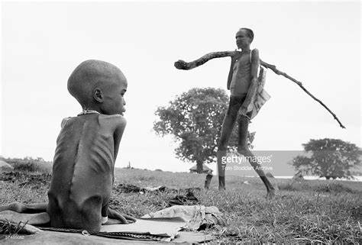
Famine
A famine is a shortage/ scarcity of food over a large area.
A famine is an acute episode of extreme hunger that results in excess mortality/ death due to starvation or hunger-induced diseases.

Slide 23
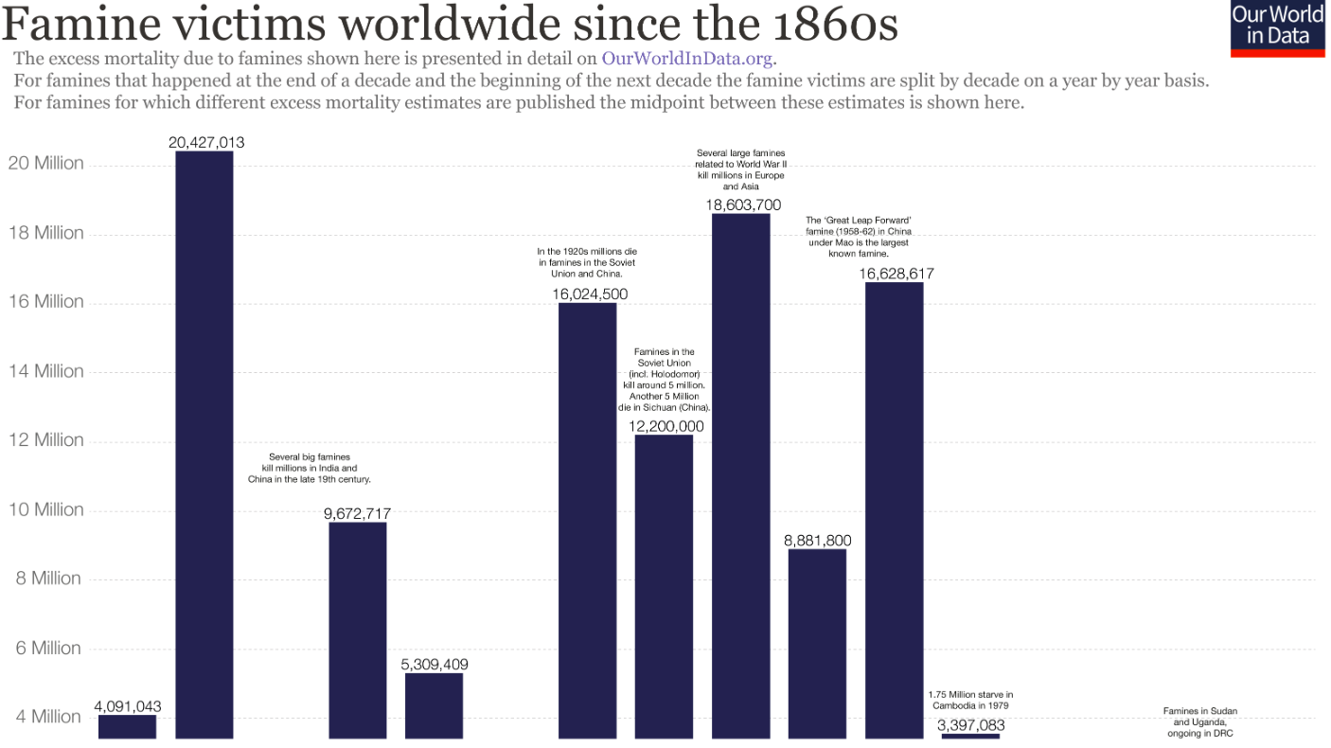
Famine

Slide 24
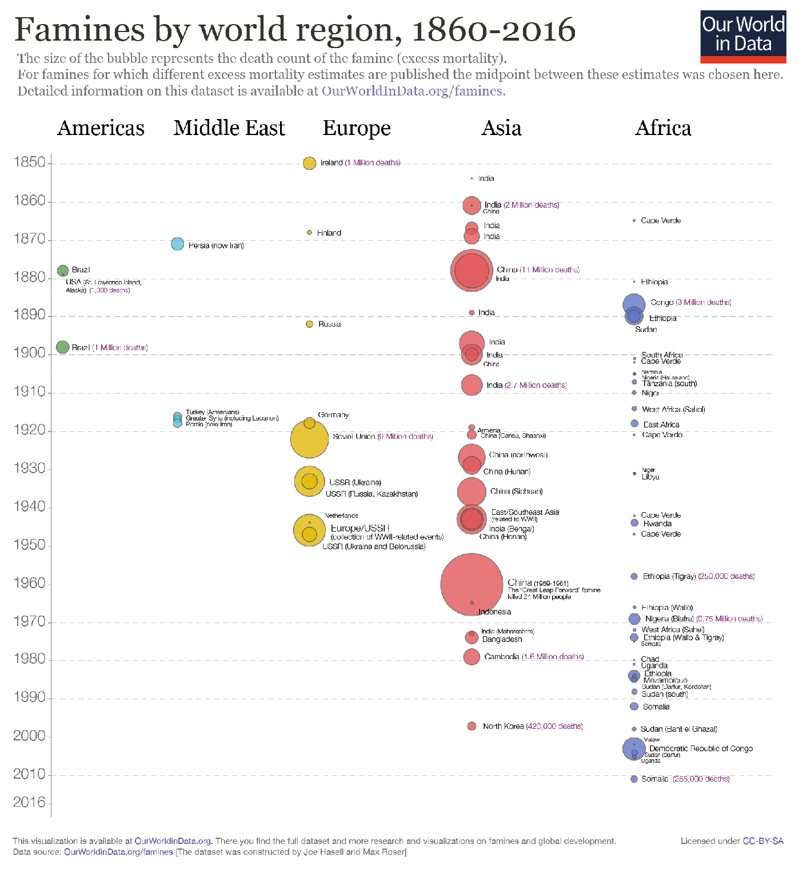

Slide 25
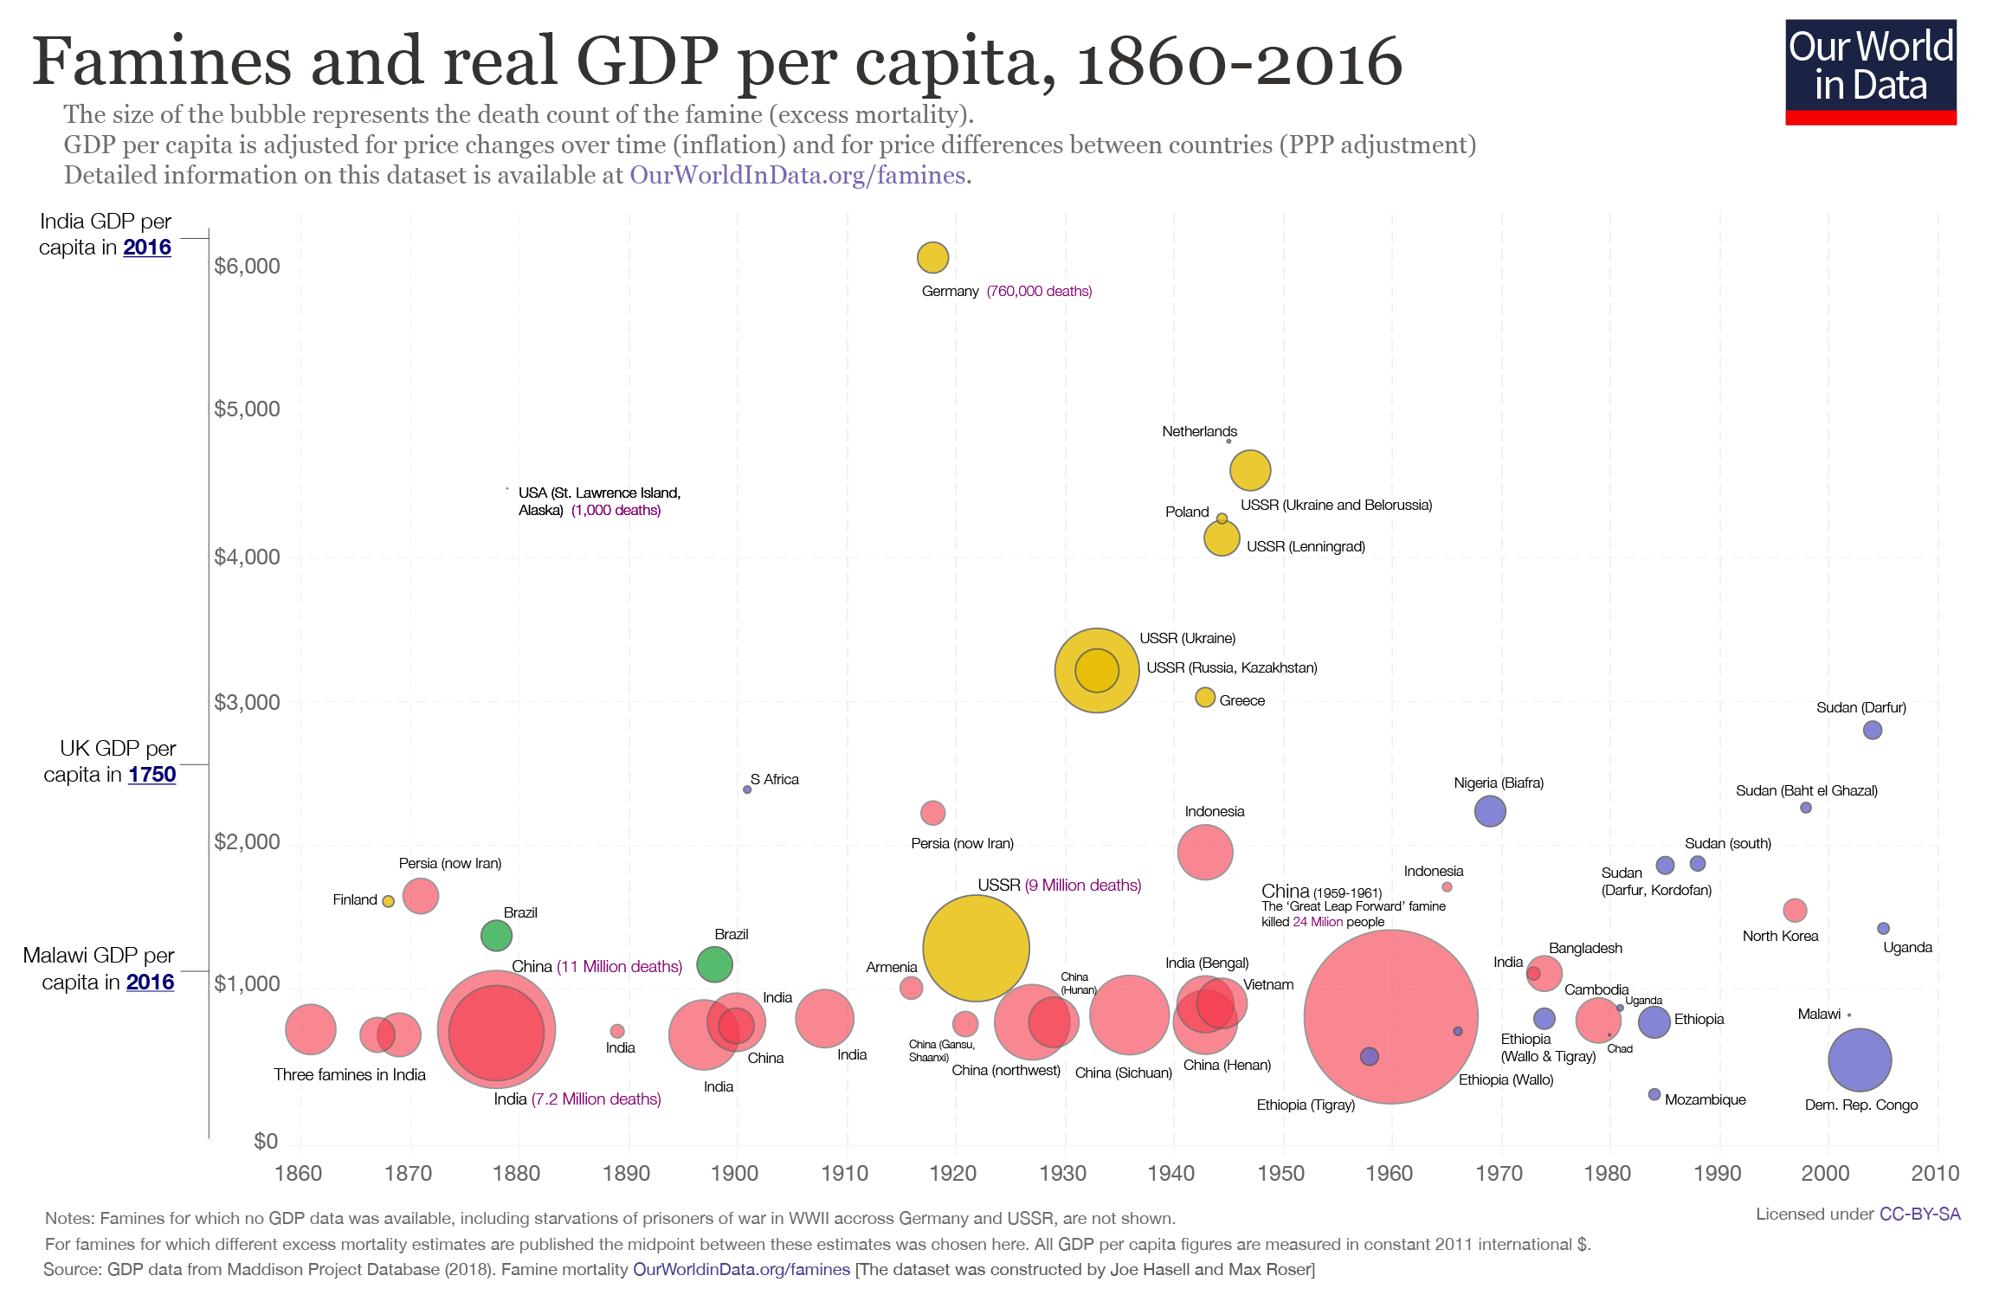
Notes:
Wealthy countries have very few people living in such extreme absolute poverty, both because of higher incomes before tax and benefits, but also due higher government expenditures and transfers. It is therefore unsurprising that those countries in which famines occur do tend to be very poor. Here we show the inflation-adjusted income per capita of each country at the time they experienced a famine, with some reference points on the vertical axis. As you can see, most countries in which a famine took place had, at the time, average incomes less than half of that of the UK at the outset of its industrial revolution. You can see that average incomes in India – a country that historically suffered very heavily from famine – has grown rapidly in recent decades, and at the same time has been famine free. African countries, conversely, have on the whole has remained very poor and make up the majority of recent famines.
As well as proxying for the presence of extreme poverty, this relationship also reflects the fact that poorer countries also tend have less adequate facilities like transport infrastructure, sanitation and systems of healthcare that play a key role in preventing or moderating the impacts of food shortages.
Whilst poverty certainly increases the vulnerability of a country, we should be careful not to think of it as the single, or even the most important, cause of famine, given the typically political nature of most outbreaks of famine.

Slide 26
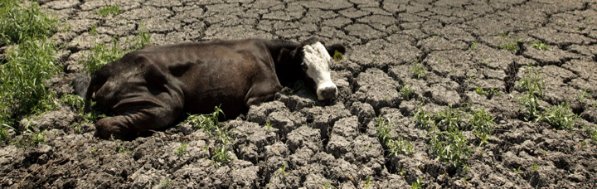
Why do famines happen?
Causes contributing to famines:
Food scarcity (due to drought, flooding)
Poverty
Increasing population
Unequal distribution of food
Further more,
Political conflicts, war
Access to market (price too high, lack of proper functioning market)
Poor healthcare systems
Notes:
Population growth? No.
The large increase in global population being met with an even greater increase in food supply (largely due to increases in yields per hectare).

Slide 27
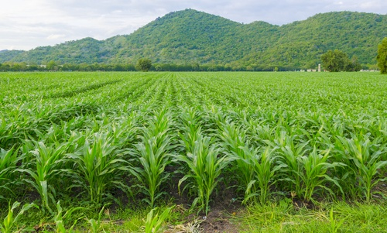
Food production - monoculture
The practice of growing only one crop or keeping only one type of animal (single variety) on an area of farm land.
This method of farming is particularly popular in industrialized regions.
What about the biodiversity in the ecosystem?

Slide 28
Pros
Cons
Reduce biodiversity in the ecosystem
Increase pests population by supplying sufficient food
Increase insecticides spray to control pests, which may harm other insects and animals
Easily strip the soil of some nutrients, also has a negative effect on the structure of the underlying soil. Soil become more susceptible to erosion (removal of topsoil which is the most fertile).
Need massive amounts of water via irrigation as moisture retention is limited in the soil
allows the farmer or organization to specialize in a specific crop or livestock
permits the increase of profits and the decrease of costs
maximizes efficiency, such as efficient use of soil and local climate conditions.
simplifies cultivation. e.g. Only one soil preparation technique is utilized. The same is true of irrigation and pest control.
Notes:
The worlds long term food production comes at risk from high use of fertilizers, pests, loss of biodiversity, soil fertility and environmental pollution. There is no simple answer in excluding negative impacts of monoculture while keeping its benefits. Introducing more crop rotation could, however, provide a solution for crop health.
Sustainable Agriculture has become increasingly important due to increased demand for food, negative impact of climate changes and limited resources.

Slide 29
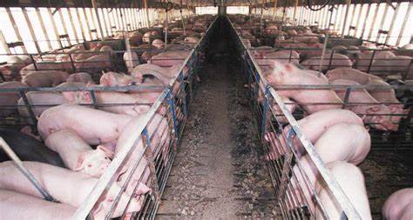
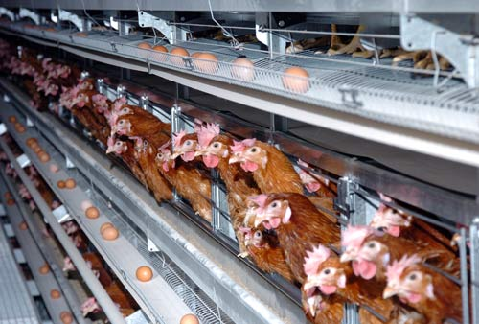
Food production - intensive livestock farming
Reduce energy loss by limit locomotion, high digestibility diet and provide suitable temperature, hence maximize growth rates and minimize costs.
Notes:
Intensive agriculture, also known as intensive farming and industrial agriculture (as opposed to extensive farming), is a type of agriculture, both of crop plants and of animals, with higher levels of input and output per cubic unit of agricultural land area. It is characterized by a low fallow ratio, higher use of inputs such as capital and labour, and higher crop yields per unit land area.

Slide 30
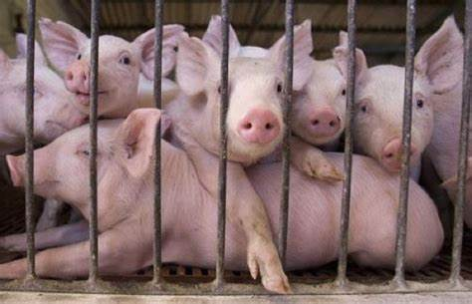
Negative effects
Various diseases and infections easily spread brought about by overcrowding and poor hygiene
Regular application of medications to prevent diseases. Also, hormones may be used to boost growth and increase yield.
Waste disposal leads to pollution of land and waterways nearby
Animal welfare issues, such as ability for livestock to perform natural acts (e.g. chicken spreading wings and flapping )

Slide 31
Food production impact on environment
The food system is the single biggest threat to nature today.
It uses most of our natural resources, with
69% of global freshwater and
Half of the world’s habitable (ice- and desert-free) land.
It has caused
75% of deforestation,
30% of topsoil erosion and
contributes at least 24% of greenhouse gas emissions.
78% of global ocean and freshwater eutrophication (the pollution of waterways with nutrient-rich pollutants)
70% of biodiversity loss and
has led to 93% of all our fish stocks being fished to their limits or beyond.
821 million people are hungry while 1.9 billion are overweight or obese.
Food, therefore, lies at the heart of trying to tackle climate change, reducing water stress, pollution, restoring lands back to forests or grasslands, and protecting the world’s wildlife.
If food is produced more sustainably, distributed fairly and consumed more responsibly, we can improve both human and planetary health
Notes:
94% of mammal biomass (excluding humans) is livestock.

